Slide 1



DAHEL TECHIES
SQL
By Modinat Ganiyu

Slide 2
AGGREGATION
Aggregation in SQL refers to the process of combining multiple values into a single value. This is done using aggregate functions. Here are some of the most commonly used aggregate functions:
•COUNT(): Counts the number of rows in a dataset.
•SUM(): Adds up the values in a numeric column.
•AVG(): Calculates the average of the values in a numeric column.
•MAX(): Finds the maximum value in a column.
•MIN(): Finds the minimum value in a column.

Slide 3
GROUP BY Clause
The GROUP BY clause is used in conjunction with aggregate functions to group the rows that have the same values in specified columns into summary rows.
It can be very useful for performing operations like counting the number of items in each category, finding the maximum value in each group, etc.
SYNTAX
SELECT column_name(s), AGGREGATE_FUNCTION(column_name)
FROM table_name
WHERE condition
GROUP BY column_name(s);

Slide 4
Get these queries:
-- Find the number of employees
-- Find the average of all employee's salaries
-- Find the sum of all employee's salaries
-- Find out how many males and females there are
-- Find the total sales of each salesman
-- Find the total amount of money spent by each client

Slide 5

-- Find the number of employees
SELECT COUNT(super_id)
FROM employee;
-- Find the average of all employee's salaries
SELECT AVG(salary)
FROM employee;
-- Find the sum of all employee's salaries
SELECT SUM(salary)
FROM employee;

Slide 6
-- Find out how many males and females there are
SELECT COUNT(sex), sex
FROM employee
GROUP BY sex
-- Find the total sales of each salesman
SELECT SUM(total_sales), emp_id
FROM works_with
GROUP BY client_id;
-- Find the total amount of money spent by each client
SELECT SUM(total_sales), client_id
FROM works_with
GROUP BY client_id;

Slide 7
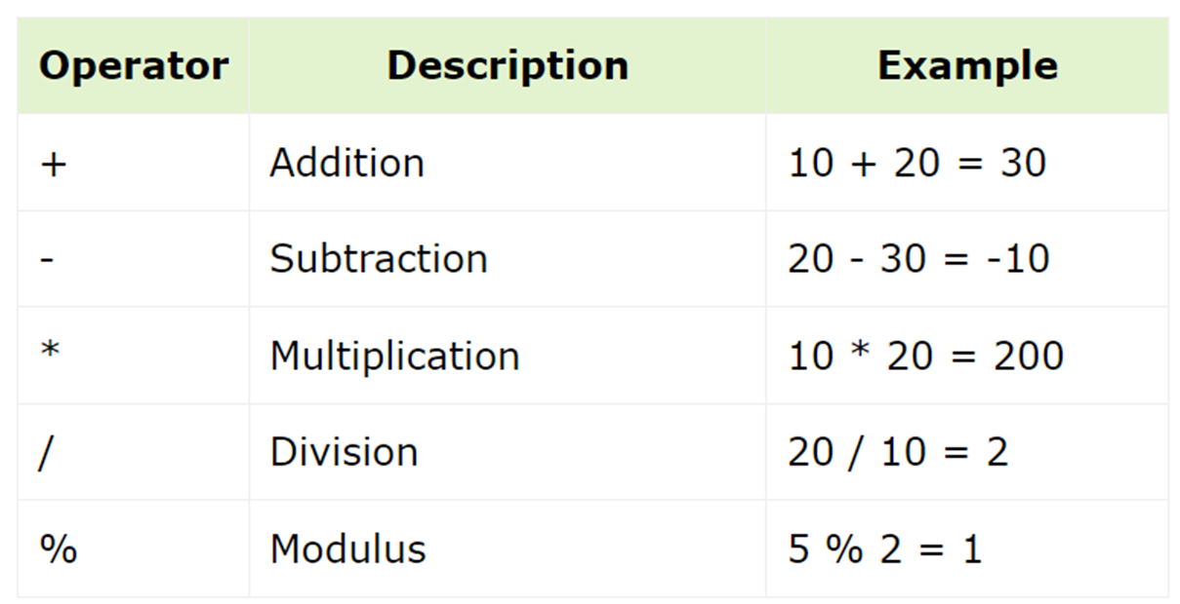
SQL Operators
SQL Arithmetic Operators
SQL Arithmetic Operators are used to perform mathematical operations on the numerical values. SQL provides the following operators to perform mathematical operations.

Slide 8
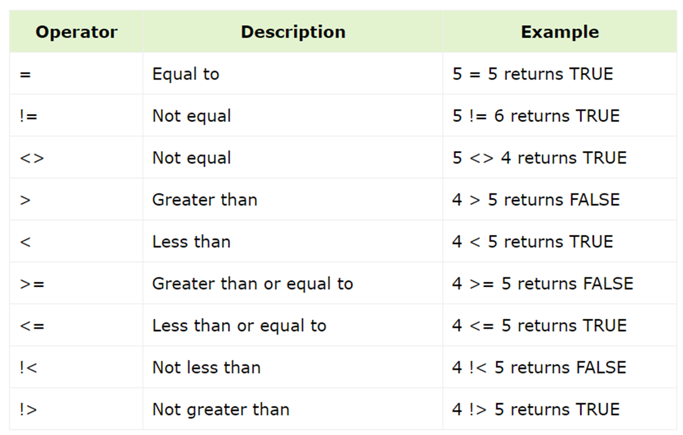
SQL Comparison Operators
SQL Comparison Operators test whether two given expressions are the same or not. These operators are used in SQL conditional statements while comparing one expression with another and they return a Boolean value which can be either TRUE or FALSE. The result of an SQL comparison operation can be UNKNOWN when one or another operand has it's value as NULL.

Slide 9
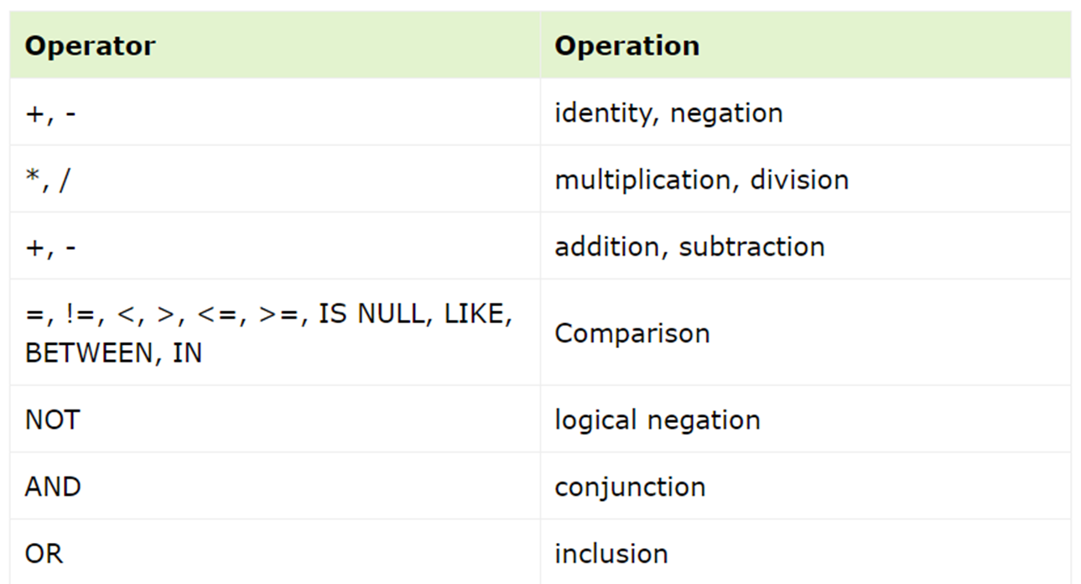
SQL Operator Precedence
The operator precedence in SQL is the sequence in which the SQL evaluates the different operators in a given expression. The operators with higher precedence get evaluated first.
Following table lists all SQL operators as per their precedence. The operators with the highest precedence are at the top and the operators with the lowest precedence are at the bottom.

Slide 10
JOIN in SQL
In SQL, a JOIN operation is used to combine rows from two or more tables, based on a related column between them. It's a powerful feature for querying a relational database because it allows you to retrieve data that is spread across multiple tables.
Types of JOINs
•INNER JOIN: Returns records that have matching values in both tables.
•LEFT JOIN (or LEFT OUTER JOIN): Returns all records from the left table, and the matched records from the right table. The result is NULL from the right side if there is no match.
•RIGHT JOIN (or RIGHT OUTER JOIN): Returns all records from the right table, and the matched records from the left table. The result is NULL from the left side if there is no match.
FULL JOIN (or FULL OUTER JOIN): Returns all records when there is a match in either left or right table. If there is no match, the result is NULL on the side that does not have a match. It combines the results of both LEFT JOIN and RIGHT JOIN.

Slide 11
SYNTAX
SELECT columns
FROM table1
JOIN table2
ON table1.common_column = table2.common_column
Get the maneger name (as an employee) of each branch:
SELECT employee.emp_id, employee.first_name, branch.branch_name
FROM employee
JOIN branch (-- LEFT JOIN, RIGHT JOIN)
ON employee.emp_id=branch.mgr_id;

Slide 12
Get the branches names that each supplier works with:
SELECT branch_supplier.branch_id, branch_supplier.supplier_name, branch.branch_name
FROM branch_supplier
JOIN branch
ON branch_supplier.branch_id=branch.branch_id;

Slide 13
Nested queries
Nested queries, also known as subqueries, are SQL queries inside a larger query. They can be used in various parts of a SQL statement, including the SELECT, FROM, WHERE, and even the HAVING clause. Nested queries can return scalar (single) values, a single row, multiple rows, or even a table.
Key Points:
•Subqueries can significantly increase the power and flexibility of SQL queries, allowing for complex data retrieval in a single query.
•The performance of subqueries can vary. Sometimes, an equivalent join might perform better, so it's worth comparing methods if performance is critical.
Nested queries must be enclosed in parentheses.
•A subquery can be used where you might use a table or a list of values.

Slide 14
-- Find names of all employees who have sold over 50,000
SELECT employee.first_name, employee.last_name
FROM employee
WHERE employee.emp_id IN (SELECT works_with.emp_id
FROM works_with
WHERE works_with.total_sales > 50000);
-- Find all clients who are handles by the branch that Michael Scott manages - Assume you know Michael's ID
SELECT client.client_id, client.client_name
FROM client
WHERE client.branch_id = (SELECT branch.branch_id
FROM branch
WHERE branch.mgr_id = 102);

Slide 15
Get these queries
List all products in the inventory
Find the total number of products in the inventory
Get the details of products that are out of stock
Find the product with the highest stock quantity
List products that need to be reordered (stock quantity below 10)
Get the total value of all products in the inventory (assuming there's a price column)
Find the average price of products in the inventory
Count the number of different product categories in the inventory

Slide 16


